Slide 1
Nuclear Fusion
Types of H fusion
PP chain
Coulomb barrier
Binding Energy
Fusion Shells
Notes:
SUMMARY
There is also a slide (11) which looks at the dominant processes by which the elements are made.

Slide 2
Nuclear Fusion
Notes:
TITLE
Use this slide to briefly introduce the topic of today’s lesson.

Slide 3
Recap
Which parts of the EM spectrum are ionising?
A star hotter than the Sun would look what colour?
How do we identify elements in stars?
Notes:
RECAP
Spend 4-5 minutes recapping the last lesson (Solar Structure). Have students answer the questions in TPS format.
UV, X-ray, Gamma
Blue/White
By taking an image of their absorption spectra using a spectroscope and comparing it to reference spectra for elements/molecules to match the lines up.

Slide 4
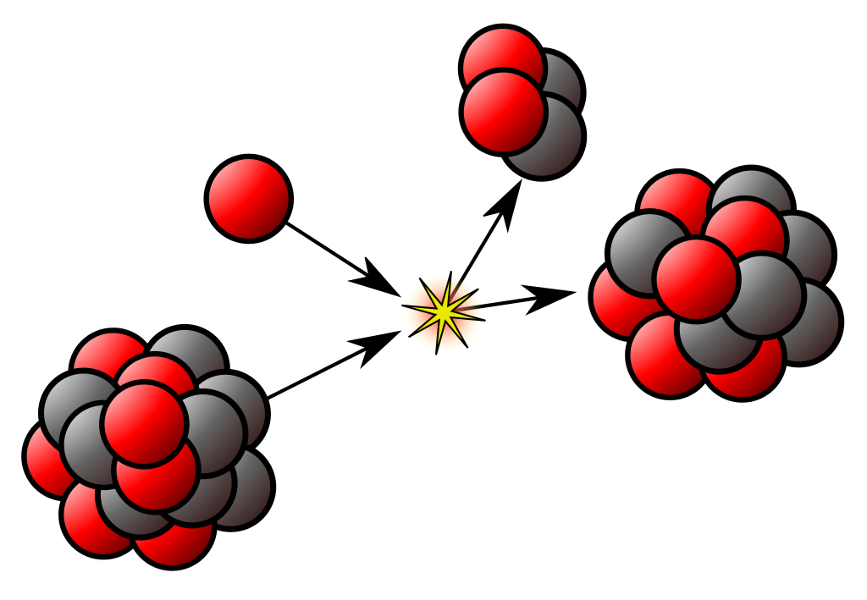
Nuclear Fusion
Two or more atomic nuclei combine to form one or more different nuclei and some subatomic particles (protons/neutrons).
Kjerish
Notes:
PRESENTATION NOTES
Red is proton and black are neutrons.
In stars fusion occurs in the core where you have a plasma. Atoms are stripped of their electrons.
SCIENCE NOTES
Definition from https://en.wikipedia.org/wiki/Nuclear_fusion
The image illustrates part of the CNO cycle.
Image from: https://en.wikipedia.org/wiki/File:NuclearReaction.svg

Slide 5
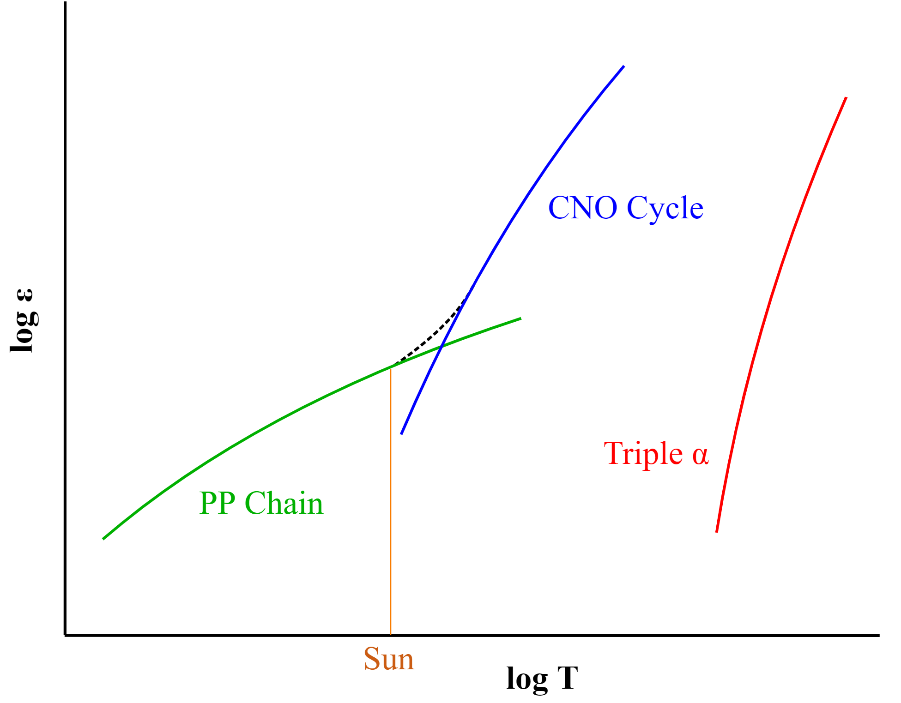
Nuclear Fusion
Three main processes for Hydrogen fusion.
PP Chain fusion at
4×10⁶ K.
Core of Sun
~15.7×10⁶ K.
RJHall
Notes:
PRESENTATION NOTES
Sun will get hotter and move to the right over its lifetime.
We will only focus on the PP chain.
Fusion is much faster at higher temps as you give the particles more energy to collide with.
SCIENCE NOTES
Epsilon is the relative energy output.
Dashed line is the combined PP and CNO energy output.
There is some generation from CNO in the Sun but it is less than 1%.
PP CNO crossover is around 17 million K
Image from: RJHall - Own work, CC BY-SA 3.0, https://commons.wikimedia.org/w/index.php?curid=5387273

Slide 6
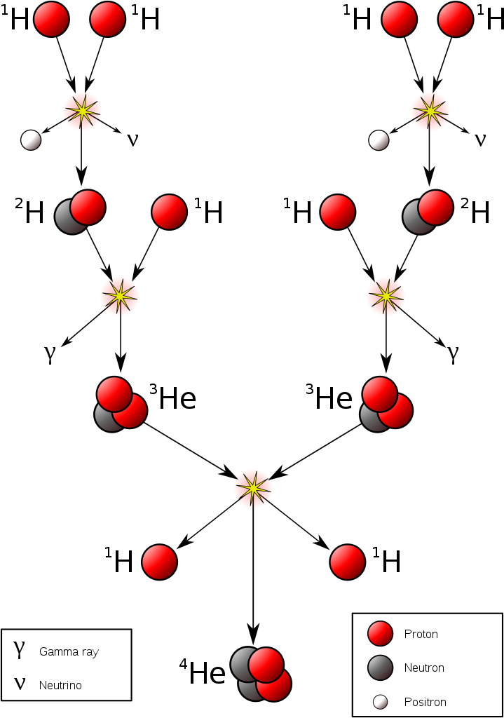
PP Chain
The first step takes a VERY long time ~9 BILLION years.
This is because the two Hydrogen nuclei are positively charged and repel.
Total energy released is:
26.73 MeV
(4.3×10⁻¹² J)
Sarang
Notes:
PRESENTATION NOTES
Positron is a positive electron (it’s an anti-particle).
SCIENCE NOTES
The neutrinos shown are electron neutrinos and result from the beta plus decay of one of the H nuclei during fusion.
There are 3 other forms of the PP chain. This one is the simplest to visualise and dominant at low (14 million K) temps.
One eV is 1.602×10⁻¹⁹ Joules.
Image from: https://commons.wikimedia.org/wiki/File:Fusion_in_the_Sun.svg

Slide 7
PP Chain
4 ¹H⁺ → ⁴He²⁺ + 2e⁺ + 2νₑ
26.73 MeV
Sarang
Notes:
PRESENTATION NOTES
Positron is a positive electron (it’s an anti-particle).
SCIENCE NOTES
The neutrinos shown are electron neutrinos and result from the beta plus decay of one of the H nuclei during fusion.
There are 3 other forms of the PP chain. This one is the simplest to visualise and dominant at low (14 million K) temps.
One eV is 1.602×10⁻¹⁹ Joules.
Image from: https://commons.wikimedia.org/wiki/File:Fusion_in_the_Sun.svg

Slide 8
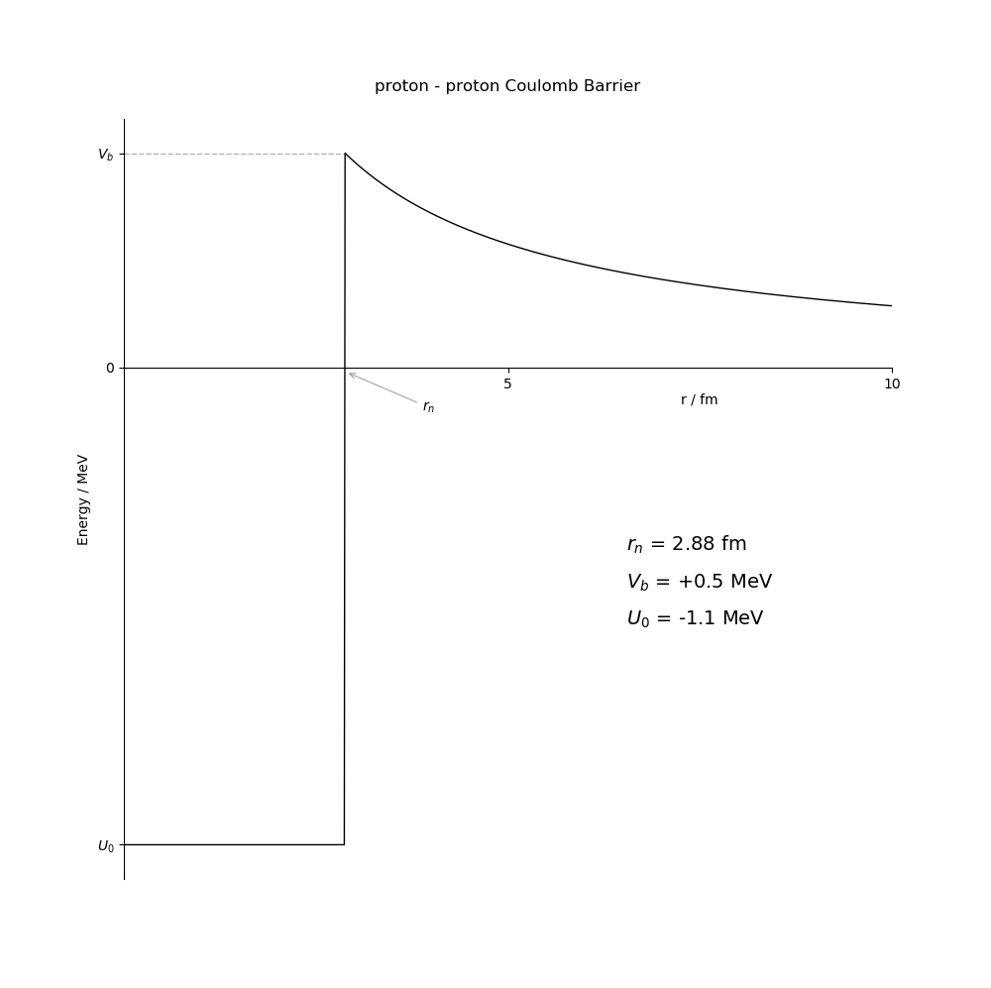
Coulomb Barrier
The two protons (Hydrogen nuclei) repel due to the electrostatic force.
They have to have enough energy to overcome the potential barrier (the peak on the diagram).
In practice they cheat using quantum tunnelling.
Notes:
PRESENTATION NOTES
If the protons are closer than 2.88 fm the Strong nuclear force takes over and the Weak nuclear force fuses them.
SCIENCE NOTES
Quantum tunnelling allows the protons to fuse at lower temperatures than classical mechanics calculates.
Vb in the diagram is the energy at the top of the barrier.
rn is the distance the two protons have to be to fuse classically. fm is femtometres.
The Uo value is the binding energy of deuterium.
Including the positron annihilating with an electron and the energy from the neutrino the Q value (energy released) is 1.442 MeV, slightly more than shown here.
I say the weak nuclear force fuses them because the beta plus decay of one of the protons is initiated by the Weak nuclear force.
Image by Dimitrios Theodorakis.

Slide 9
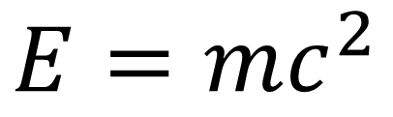
Binding Energy
The mass of the Helium is less than the mass of the four protons.
This mass difference is released as energy.
$$E=mc^{2}$$
Sarang
Notes:
PRESENTATION NOTES
Specifically this is the Nuclear Binding Energy since we are talking about the nucleus.
The mass of the product is less than the mass of the reactants.
SCIENCE NOTES
The binding energy here is the energy needed disassemble a nucleus into its constituent particles.
Image from: https://commons.wikimedia.org/wiki/File:Fusion_in_the_Sun.svg

Slide 10
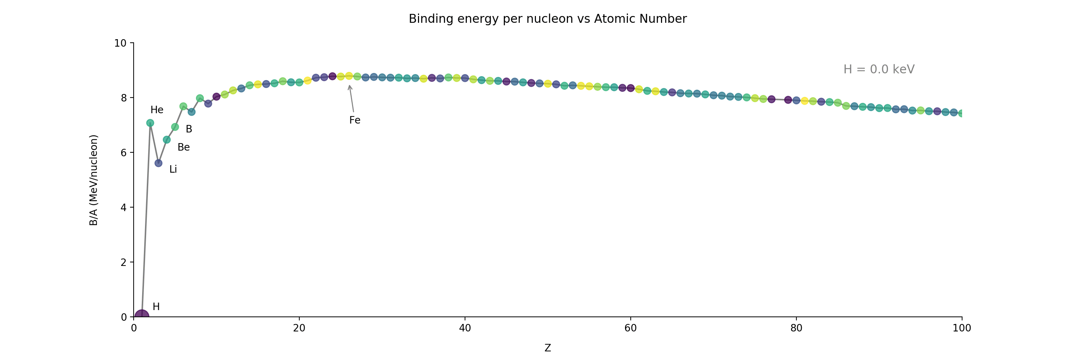
Binding Energy
Notes:
PRESENTATION NOTES
The greatest jump is at the start purely because there is only one subatomic particle for Hydrogen so nothing is bound and there is no binding energy.
SCIENCE NOTES
Fusion of iron and heavier elements requires energy so stars stop fusing at iron.
Atomic number is the number of protons in the nucleus.
Elements heavier than Iron are produced via other processes.
Image by Dimitrios Theodorakis.

Slide 11
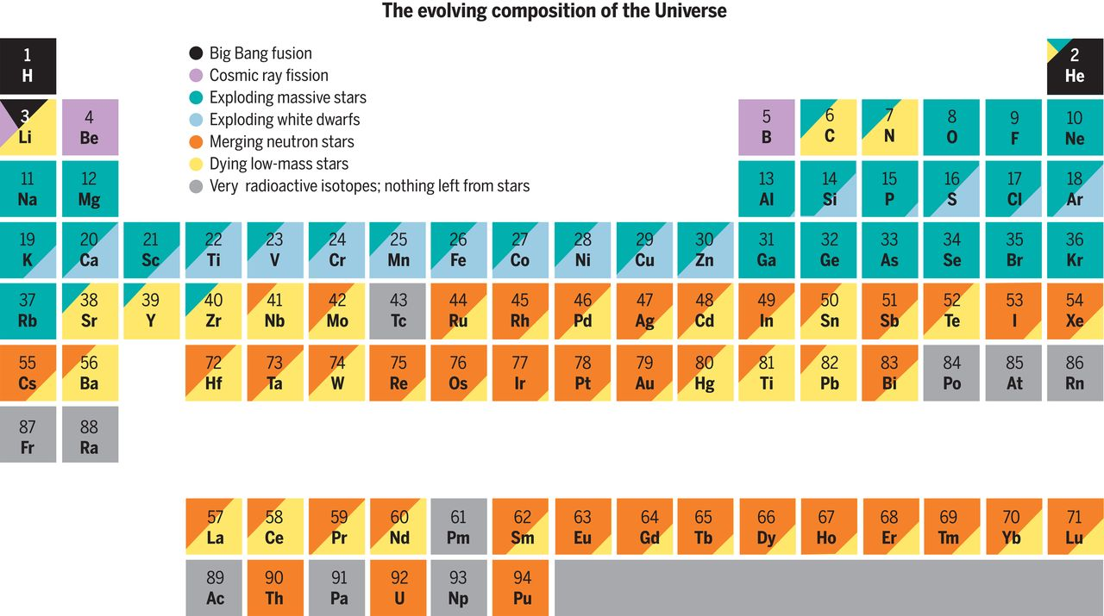
J.A. Johnson
Notes:
PRESENTATION NOTES
The bottom row of the table isn’t shown as they are all man-made elements.
This is for the Universe and you can see all elements apart from H, He, Be, B and radioactive isotopes are produced by stars fusing or dying.
SCIENCE NOTES
The article below explains in detail why low mass stars produce more of the heavier elements. In essence low mass stars produce lots of neutrons which can be captured by iron and heavier elements in the Sun to form even heavier elements. Massive stars die so fast they can’t produce these massive stars.
Image from: DOI: 10.1126/science.aau9540 Populating the periodic table: Nucleosynthesis of the elements https://science.sciencemag.org/content/sci/363/6426/474.full.pdf

Slide 12
Recap
Which has more mass: 4 protons or 1 Helium nucleus
What force prevents two protons from colliding?
Which Hydrogen fusion process dominates at high temperatures?
Why can’t a star fuse past Iron?
Notes:
RECAP
Spend 4-5 minutes recapping. Have students answer the questions in TPS format.
4 protons
Electrostatic
Triple alpha
It takes more energy to fuse these elements than it releases

Slide 13
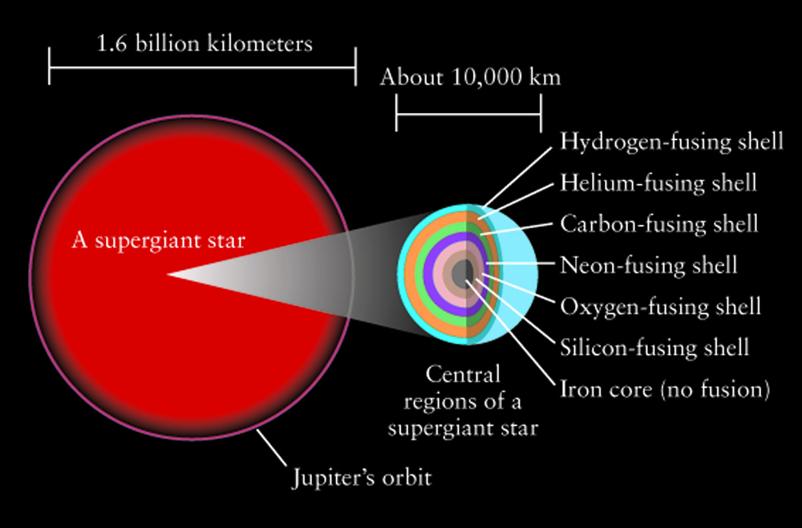
Fusion Shells
Really big stars can fuse up to Iron.
After most of the Hydrogen is used you have a lot of Helium which sinks to the centre.
This heats up the star so that it can fuse Helium and causes a Helium flash.
D Pogosyan
Notes:
PRESENTATION NOTES
Each time before you get the next fusing shell there is a flash after fusion starts.
SCIENCE NOTES
Really big is 10 times the mass of the Sun.
The sinking Helium increases the gravitational pull at the core (the core is basically collapsing), this means you need a greater radiation pressure (amount of photons) coming from the core to balance this gravitational pull. The collapse heats the core up to temperatures where Helium can be fused. When the gravitational attraction inwards and the radiation pressure outwards are balanced the star is in hydrostatic equilibrium.
Image from: https://sites.ualberta.ca/~pogosyan/teaching/ASTRO_122/lect18/lecture18.html

Slide 14
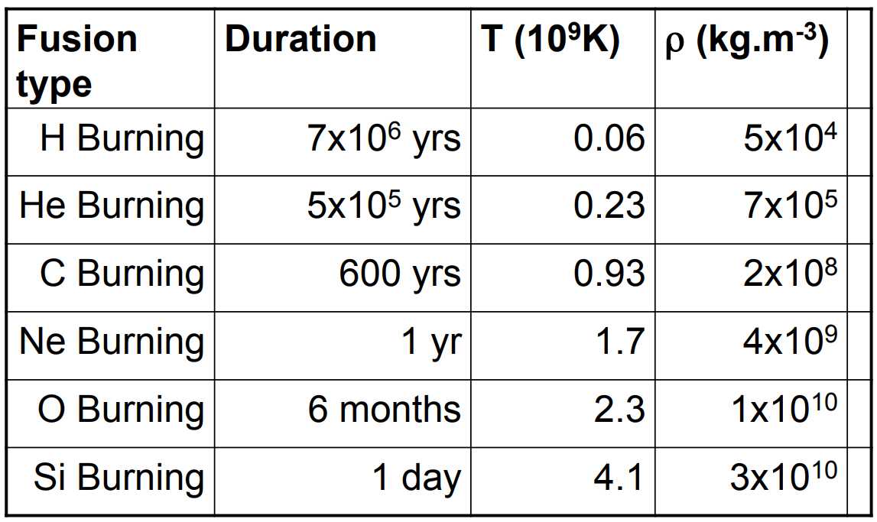
25 Solar Mass Star
Sheffield Uni
Notes:
PRESENTATION NOTES
Even shorter durations past silicon!
SCIENCE NOTES
Larger stars fuse their fuel more rapidly than stars like our Sun so they evolve and die quicker.
This star will most likely explode in a supernova and form a black hole.
Image from: https://www.sheffield.ac.uk/polopoly_fs/1.464670!/file/Topic4.pdf

Slide 15
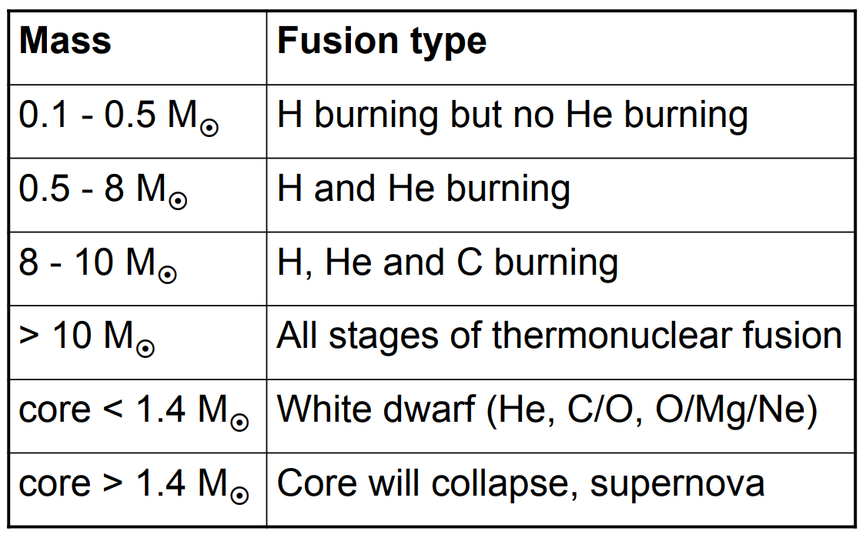
Mass vs Fusion Process
Sheffield Uni
Notes:
PRESENTATION NOTES
This is all relative to the mass of the Sun.
SCIENCE NOTES
1.4 solar masses is the Chandrasekhar Limit. If the core mass exceeds this it collapses!
Image from: https://www.sheffield.ac.uk/polopoly_fs/1.464670!/file/Topic4.pdf

Slide 16
Recap
What shell comes after Helium?
Does the Hydrogen at the very edge of the star fuse?
Which lasts longer Helium or Neon burning?
Define hydrostatic equilibrium.
Notes:
RECAP
Spend 4-5 minutes recapping the last lesson. Have students answer the questions in TPS format.
Carbon
No only in the core are temperatures hot enough to fuse
Helium (lighter elements have longer burn times)
When the outward radiation pressure balances the inward gravitational pull the star is in hydrostatic equilibrium

Slide 17
Observing the Night Sky
Up next:
Notes:
PRESENTATION NOTES
The next PPT is on Observing the Night Sky

